Slide 1
Automatic Control
By
Dr. / Mohamed Ahmed Ebrahim Mohamed
E-mail: mohamedahmed_en@yahoo.com
Web site: http://bu.edu.eg/staff/mohamedmohamed033

Slide 2
Lecture (1)

Slide 3
BODE PLOT

Slide 4
BODE PLOT
1
Introduction.
2
Frequency Response Definition.
Bode Plot Construction.
7
5
6
4
3
Bode Plot Definition.
Frequency Response Plot.
Viewpoints of analyzing control system behavior.
Logarithmic coordinate.

Slide 5
Frequency Response Definition
What is frequency response of a system?
The frequency response of a system is defined as the steady-state response of the system to a sinusoidal input signal.
The sinusoid is a unique input signal, and the resulting output signal for a linear system, as well as signals throughout the system, is sinusoidal in the steady-state.

Slide 6
Bode Plot Definition
What is Bode Plot?
Bode Plot is a (semi log) plot of the transfer function magnitude and phase angle as a function of frequency.

Slide 7
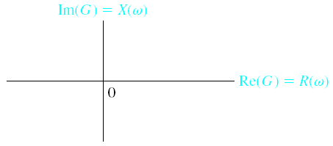
Frequency Response Plots
Polar Plots

Slide 8
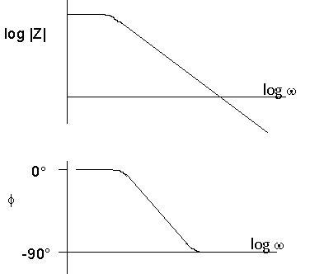
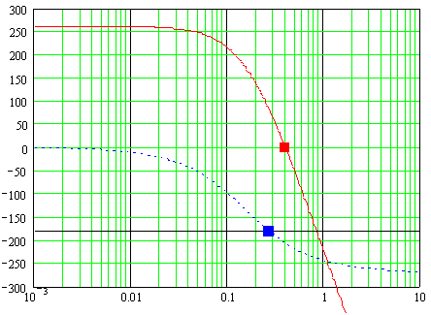
Frequency Response
The transfer function can be separated into magnitude and phase angle information
H(jω) = |H(jω)| ∠Φ(jω)
e.g.,
H(jω)=Z(jω)

Slide 9
Viewpoints of analyzing control system behavior
Routh-Hurwitz
Root locus
Bode diagram (plots)
Nyquist plots
Nicols plots
Time domain

Slide 10
L.T.I system
Magnitude:
Phase:
G(s)
＋
－
Steady state response
H(s)
Magnitude:
Phase:

Slide 11
Logarithmic coordinate
Decade :
Octave :
dB
The gain magnitude is many times expressed in terms of decibels (dB)
dB = 20 log₁₀ A
where A is the amplitude or gain
a decade is defined as any 10-to-1 frequency range
an octave is any 2-to-1 frequency range
20 dB/decade = 6 dB/octave

Slide 12
Bode Plot Construction
Case I : k
Magnitude:
Phase:

Slide 13
Case II :
Magnitude:
Phase:

Slide 14
Case III :
Magnitude:
Phase:

Slide 15
Case IV :
Magnitude:
Phase:

Slide 16
Case V :
Magnitude:
Phase:

Slide 17
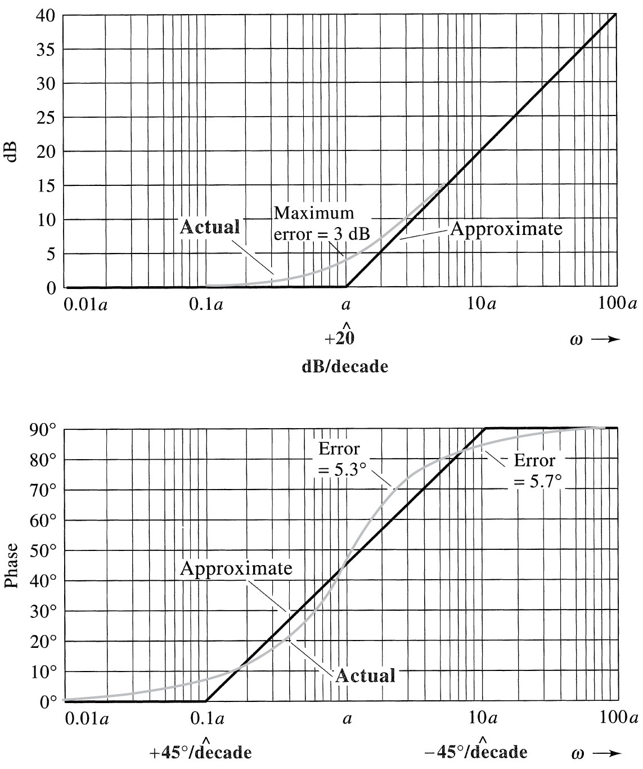

Slide 18
Case VI :

Slide 19
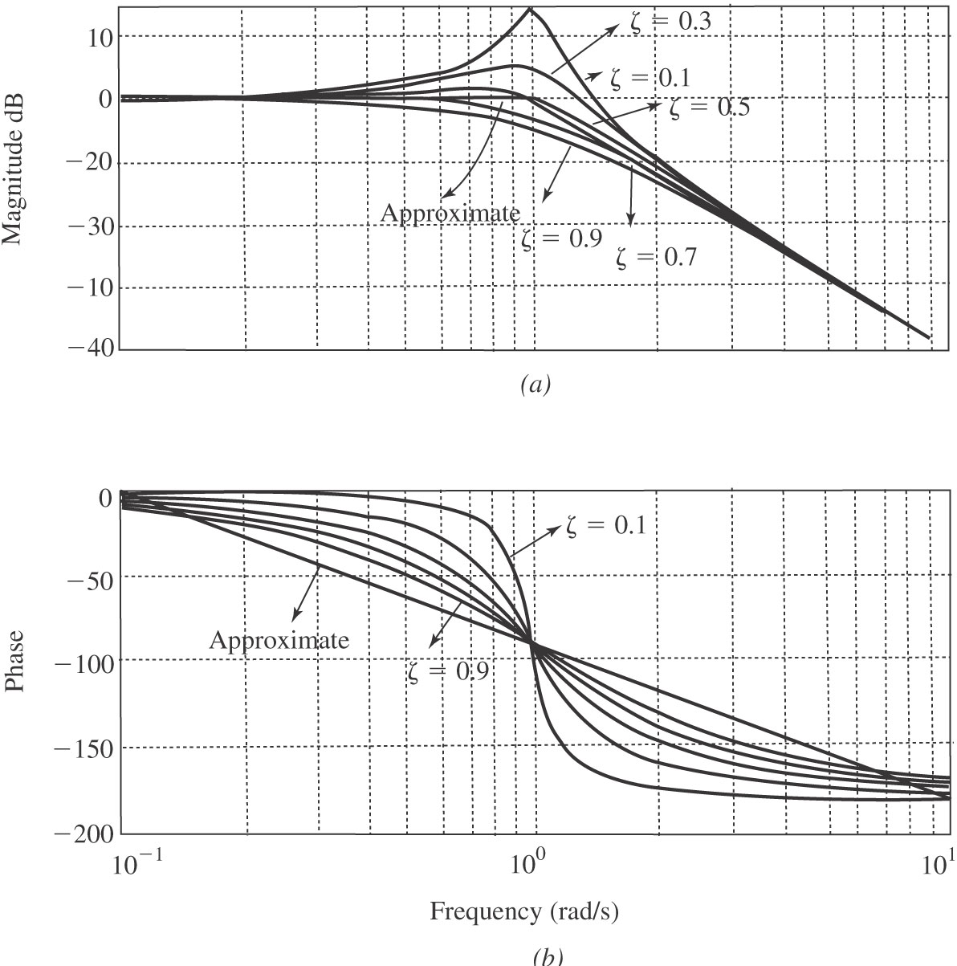

Slide 20
Example :

Slide 21
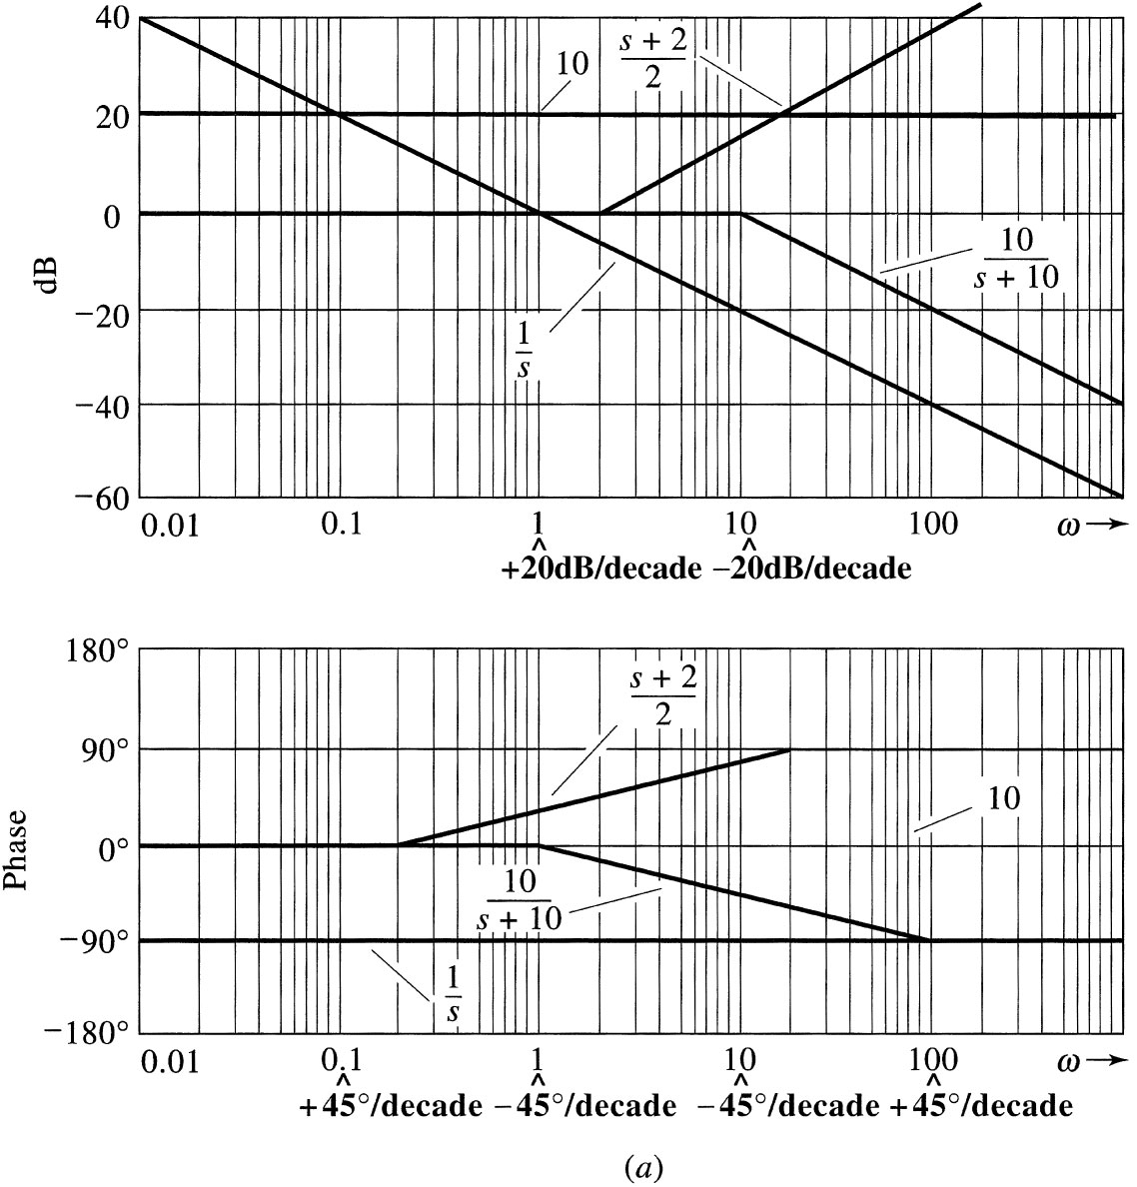
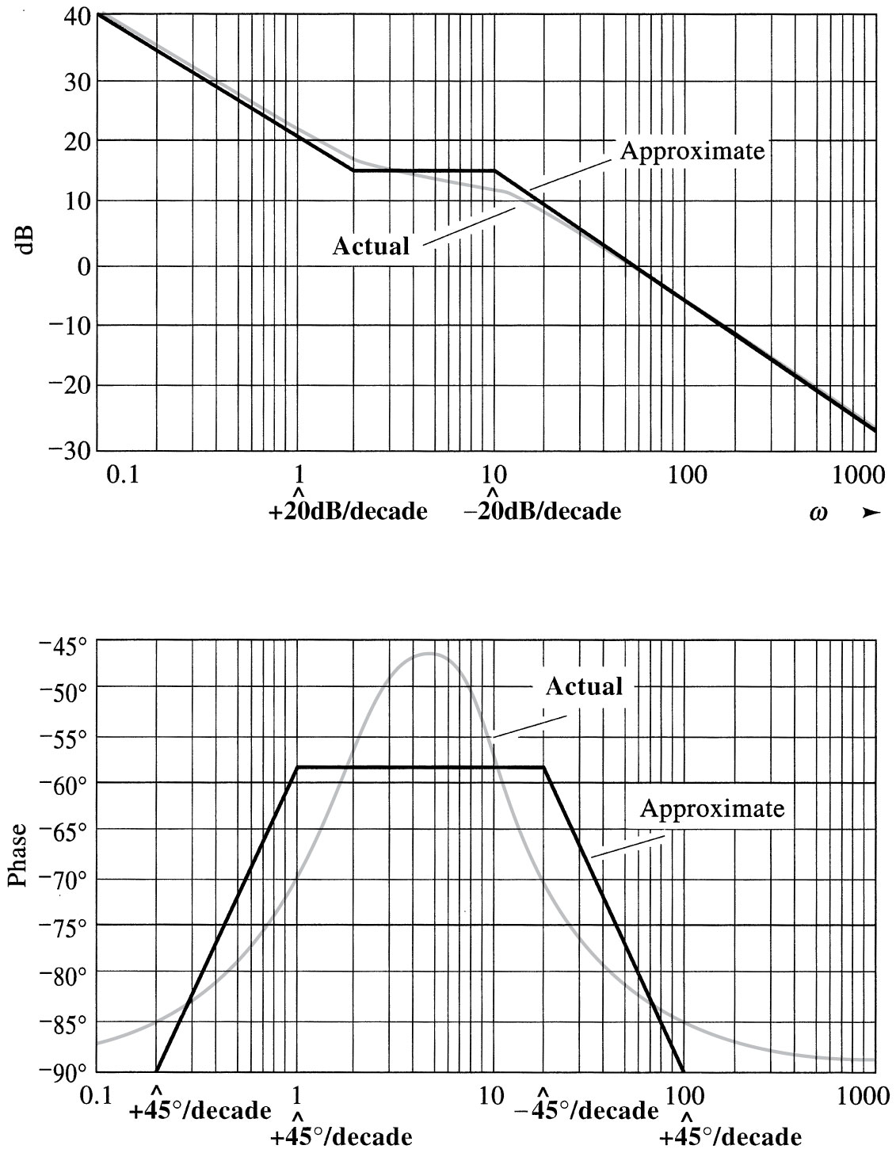

Slide 22
Minimum phase system
Type 0 : (i.e. n=0)
0dB/dec

Slide 23
Type I : (i.e. n=1)
-20dB/dec
-40dB/dec

Slide 24
Type 2 : (i.e. n=2)
-40dB/dec
-60dB/dec

Slide 25
Relative Stability
A transfer function is called minimum phase when all the poles and zeroes are LHP and non-minimum-phase when there are RHP poles or zeroes.
Minimum phase system
Stable
The gain margin (GM) is the distance on the bode magnitude plot from the amplitude at the phase crossover frequency up to the 0 dB point. GM=-(dB of GH measured at the phase crossover frequency)
The phase margin (PM) is the distance from -180 up to the phase at the gain crossover frequency. PM=180+phase of GH measured at the gain crossover frequency

Slide 26
Open loop transfer function :
Closed-loop transfer function :
Open loop Stability → poles of in LHP
Im
Closed-loop Stability →
poles of in left side of (-1,0)
RHP
Re

Slide 27
Gain crossover frequency:
G.M.>0
phase crossover frequency:
Stable system
P.M.>0

Slide 28
G.M.<0
Unstable system
Stable system
P.M.<0
Unstable system

Slide 30
Bode Plot Summary
Straight-line approximations of the Bode plot may be drawn quickly from knowing the poles and zeroes
response approaches a minimum near the zeroes
response approaches a maximum near the poles
The overall effect of constant, zero and pole terms

Slide 31
Bode Plot Summary
Express the transfer function in standard form
There are four different factors:
Constant gain term, K
Poles or zeroes at the origin, (jω)^{±N}
Poles or zeroes of the form (1+ jωτ)
Quadratic poles or zeroes of the form 1+2ζ(jωτ)+(jωτ)²

Slide 32
Bode Plot Summary
We can combine the constant gain term (K) and the N pole(s) or zero(s) at the origin such that the magnitude crosses 0 dB at
Define the break frequency to be at ω=1/τ with magnitude at ±3 dB and phase at ±45°

Slide 33
Bode Plot Summary
where N is the number of roots of value τ

Slide 34
Single Pole & Zero Bode Plots
Gain
ω_{p}
Gain
ω_{z}
0 dB
+20 dB
–20 dB
0 dB
ω
ω
Phase
One Decade
Phase
One Decade
0°
+90°
–45°
+45°
–90°
0°
ω
ω
Pole at ω_{p}=1/τ
Zero at ω_{z}=1/τ
Assume K=1
20 log₁₀(K) = 0 dB

Slide 35
Bode Plot Refinements
Further refinement of the magnitude characteristic for first order poles and zeros is possible since
Magnitude at half break frequency: |H(½ω_{b})| = ±1 dB
Magnitude at break frequency: |H(ω_{b})| = ±3 dB
Magnitude at twice break frequency: |H(2ω_{b})| = ±7 dB
Second order poles (and zeros) require that the damping ratio (ζ value) be taken into account; see Fig. 9-30 in textbook

Slide 36
Bode Plots to Transfer Function
We can also take the Bode plot and extract the transfer function from it (although in reality there will be error associated with our extracting information from the graph)
First, determine the constant gain factor, K
Next, move from lowest to highest frequency noting the appearance and order of the poles and zeros

Slide 37
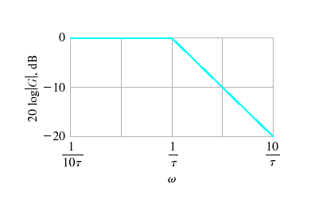
Frequency Response Plots
Bode Plots – Real Poles (Graphical Construction)

Slide 38
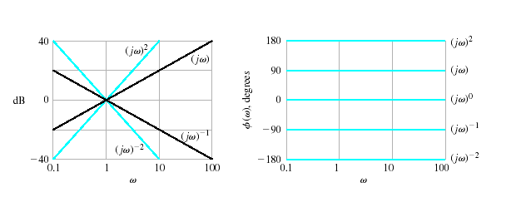
Frequency Response Plots
Bode Plots – Real Poles

Slide 39
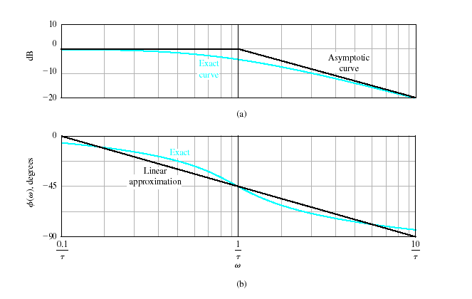
Frequency Response Plots
Bode Plots – Real Poles

Slide 40
Gain and Phase Margin
Let's say that we have the following system:
where K is a variable (constant) gain and G(s) is the plant under consideration.
The gain margin is defined as the change in open loop gain required to make the system unstable. Systems with greater gain margins can withstand greater changes in system parameters before becoming unstable in closed loop. Keep in mind that unity gain in magnitude is equal to a gain of zero in dB
The phase margin is defined as the change in open loop phase shift required to make a closed loop system unstable.
The phase margin is the difference in phase between the phase curve and -180 deg at the point corresponding to the frequency that gives us a gain of 0dB (the gain cross over frequency, Wgc).
Likewise, the gain margin is the difference between the magnitude curve and 0dB at the point corresponding to the frequency that gives us a phase of -180 deg (the phase cross over frequency, Wpc).

Slide 41
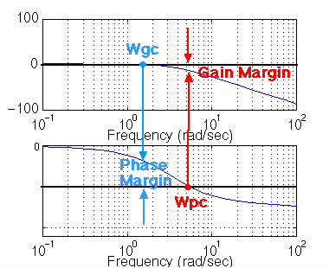
Gain and Phase Margin
-180

Slide 42
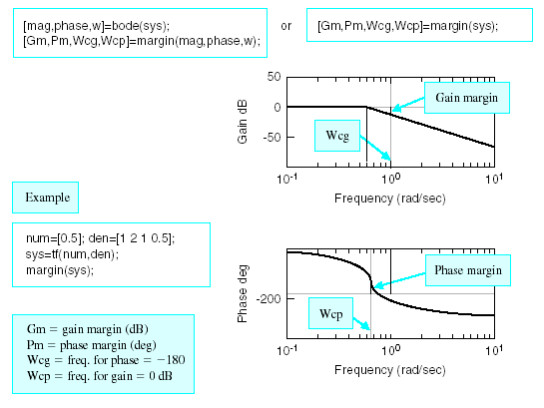
Examples - Bode

Slide 43
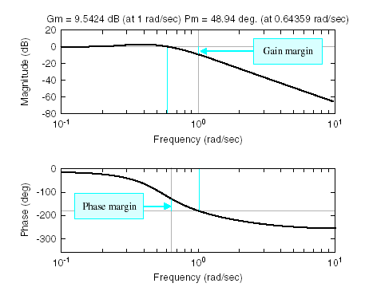
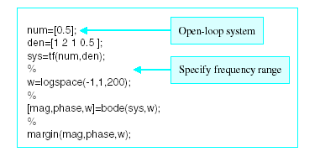
Examples - Bode

Slide 44
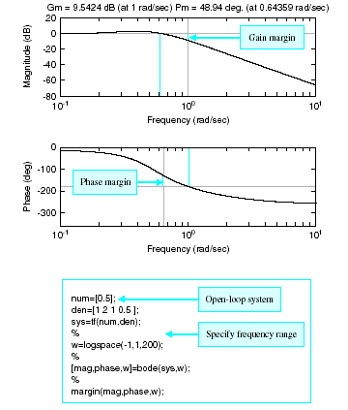
Examples – Bode

Slide 45
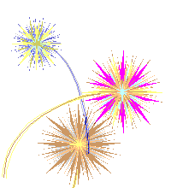
Thank You
For Your Attention
Mohamed Ahmed Ebrahim

